Slide 1
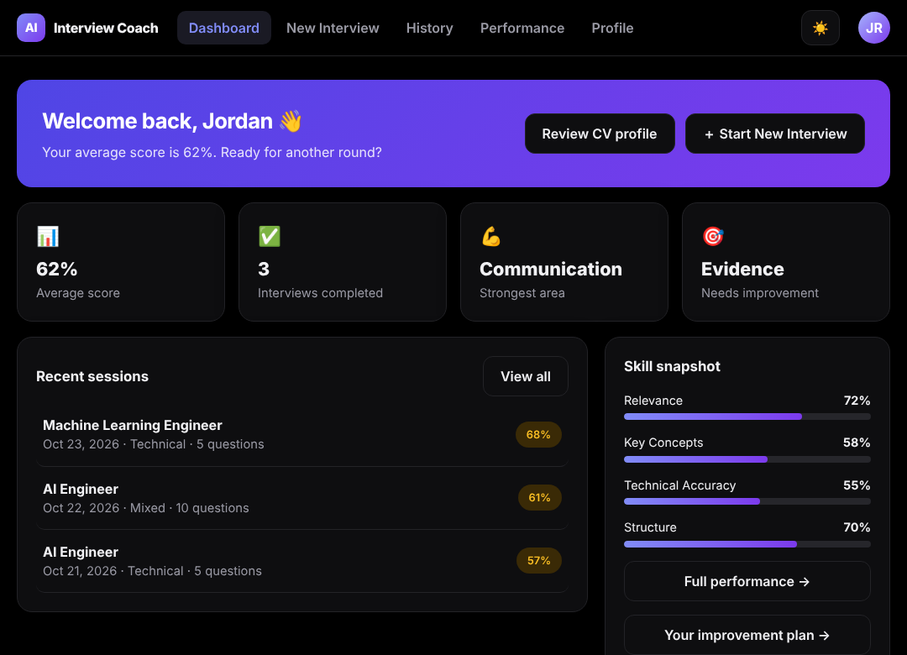

TEAM 147 · AI CAPSTONE PROJECT
AI Interview Coach
Walk into every interview prepared and confident.
CV-aware interview practice with explained scoring and a personal improvement plan.
Hybrid track: NLP + LLMs & RAG
October 2026
Notes:
Introduce the team and the project in one sentence: a web application that helps students and job seekers practise interviews with feedback they can trust and act on. The screenshot is the real dashboard in dark mode with sample data.

Slide 2



Candidates practise without specific, repeatable feedback
THE PROBLEM
Generic question lists
Scarce mock interviews
Subjective self-review
Not tied to the candidate’s own CV or to the role they want.
Mentors and career centres help, but are hard to book and to repeat.
Hard to tell which answers are weak, and why.
Notes:
Three common ways people prepare all fall short: static lists ignore the person, human mock interviews are scarce, and self-assessment is subjective. Source: Document 1, section 1.1.2.

Slide 3


Your own CV, every score explained, a plan to follow
OUR SOLUTION
1
2
3
4
5
Upload CV and confirm profile
Choose role, type and difficulty
Answer questions chosen for you
Read explained feedback and follow-ups
Follow your improvement plan
Runs on our own server: no paid AI service is needed, and no CV text leaves the machine by default.
Notes:
The whole journey in five steps. Decision D4 of the API specification: no paid or external AI in the MVP; a curated question bank and explainable rules instead.

Slide 4
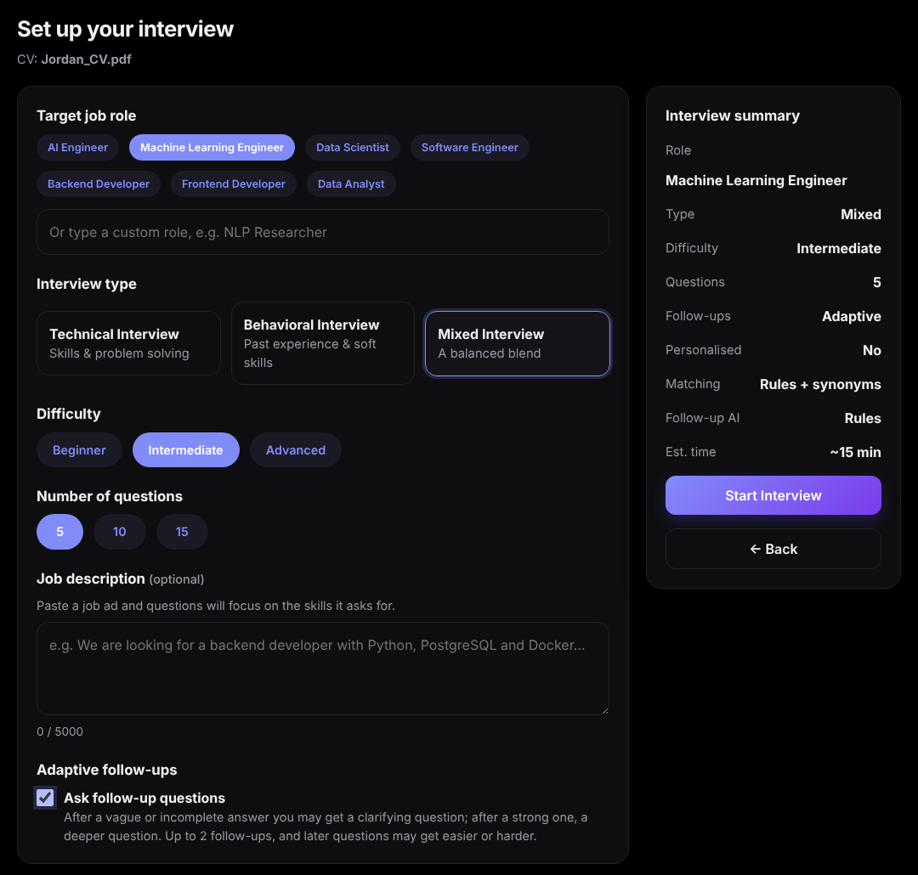
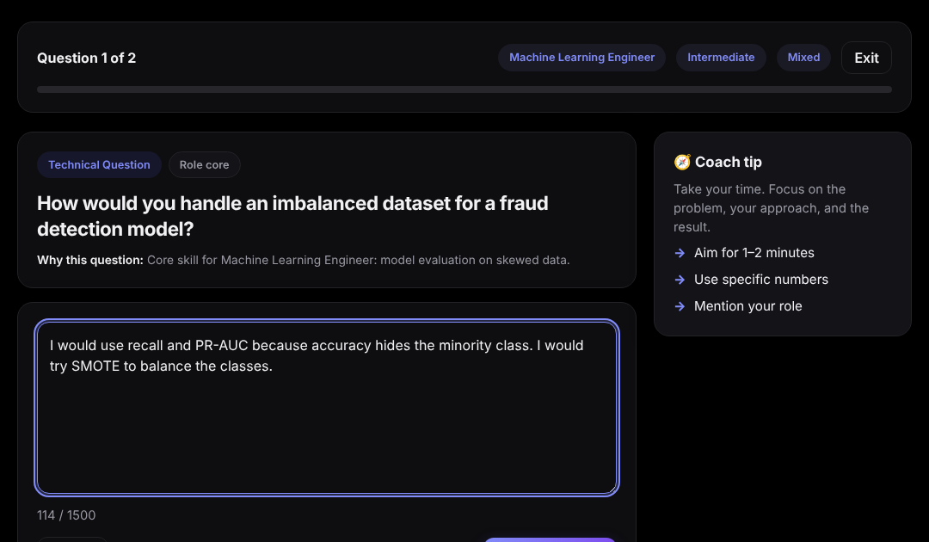
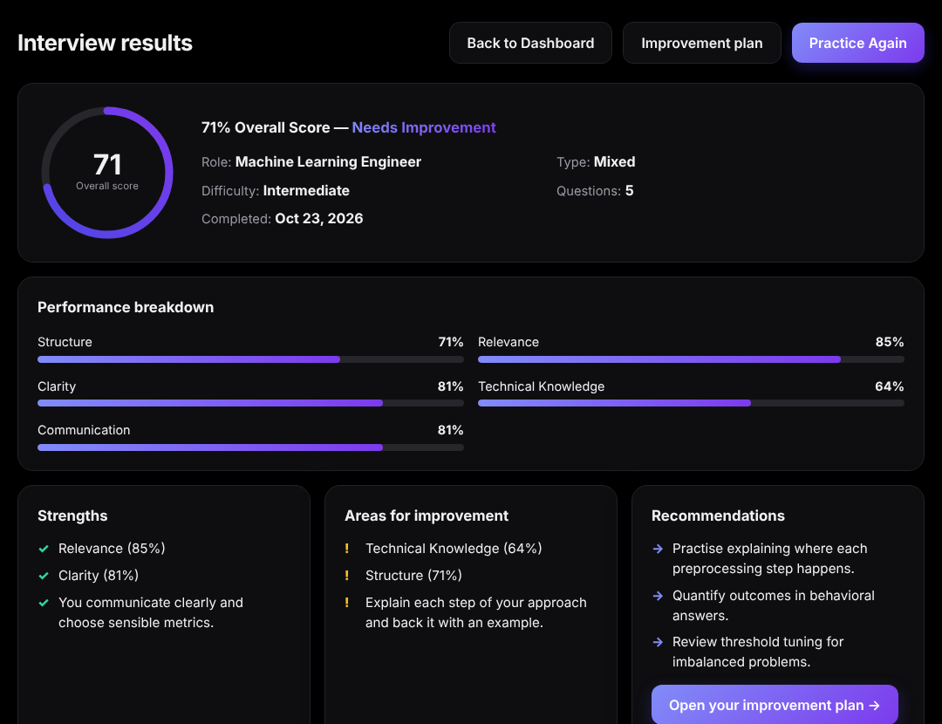
One interview, from setup to results
THE PRODUCT
1 Set up the interview
2 Answer, with the reason for each question
3 Results, breakdown and plan
Notes:
Live demo here if possible (about six minutes, script in Document 7, section 7.3.2). Use only synthetic data. Screens are the real app in dark mode with sample data.

Slide 5
A layered monolith: rules decide, AI adds evidence
ARCHITECTURE
Presentation
React 18 + Vite SPA
Optional embeddings
Local all-MiniLM-L6-v2; lexical engine by default
13 pages
32 components
api.js client
Light / dark
API
FastAPI /api/v1
Auth + JWT
Validation
Error envelope
Per-user data
Intelligence
In-process, deterministic first
Rubric scorer
Retrieval
Interview agent
Coaching
Optional LLM
Off by default, local first; can only propose
Data
PostgreSQL + Alembic
11 tables
Private CVs
Question bank
Competencies
Notes:
Why a monolith: one database, a six-person team and scoring that takes milliseconds do not justify microservices; the layer boundaries still let us swap the scorer, retrieval or LLM. In production one container serves the app and the API from the same origin. Document 4, section 4.4.

Slide 6
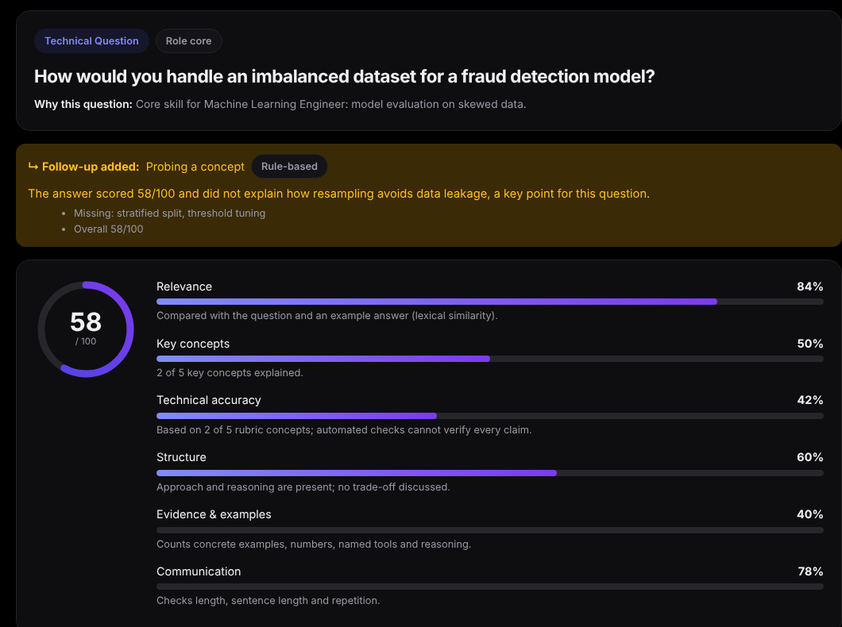
Six explained dimensions, not one opaque number
ANSWER EVALUATION
Weights for a technical question
Relevance
20%
Key concepts
25%
Technical accuracy
20%
Structure
10%
Evidence and examples
15%
Communication
10%
Similarity is only supporting evidence: accuracy is 0 when no rubric concept is covered, so matching words alone cannot score high.
Notes:
Each answer gets six scores, each with a one-line explanation, and an overall weighted score. The figure is called a score, not confidence (decision D5). Behavioral questions use different weights and do not assess technical accuracy.

Slide 7
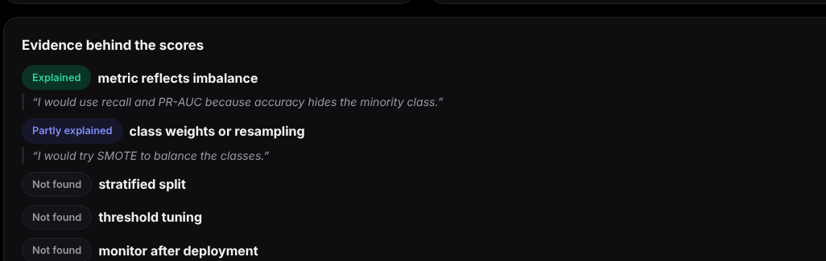
Feedback quotes the answer; follow-ups are policy-checked
EVIDENCE AND THE INTERVIEW AGENT
98.6%
appropriate follow-up decisions
was 87.7%
Five agent actions
100%
fallback to rules when the LLM fails
timeouts, invalid or off-topic output
continue
clarify
request example
probe concept
deepen
An optional LLM may only propose; rules decide if a proposal breaks a limit, leaves the rubric or goes off topic.
Notes:
Concept statuses: explained, partly explained, named only, not found, with the sentence from the answer as evidence. Limits: one follow-up per question, none on a follow-up, two to four per interview, two per competency. Benchmark on developer-labelled cases with the lexical engine (Document 6, 6.3.3).

Slide 8
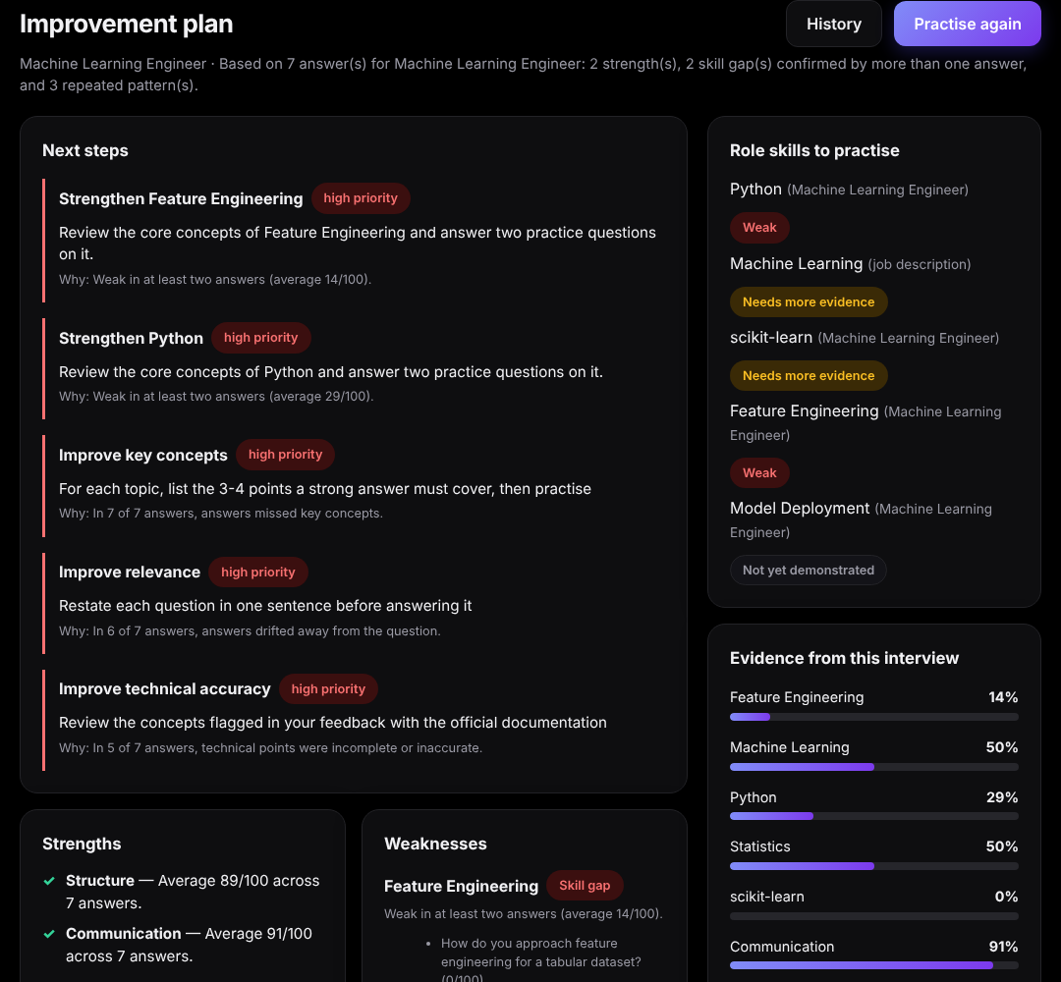

Questions fit the person; the plan follows the evidence
PERSONALISATION AND COACHING
0.856
required-skill coverage per interview
was 0.667
21.4%
questions repeated in the next interview
was 76.4%
A skill gap needs two weak answers; one weak answer is “needs more evidence”.
Notes:
Selection uses the role’s required and preferred skills, the job description and the confirmed profile; it skips near-duplicates and down-ranks recent questions. Measured over 42 planned interviews. The plan compares what the CV claims with what the interviews showed.

Slide 9



A CV is personal data: it stays in its owner’s account
SECURITY AND PRIVACY
Accounts and sessions
Per-user isolation
scrypt passwords, 15-minute tokens, rotating HttpOnly refresh cookie with theft detection
Every query is scoped to the signed-in user; other users’ data returns 404
Private CV files
No CV text to AI services
Type checked by content, stored under random names, never served
The optional LLM is off and local-first; contact details are removed
Notes:
Mitigates risks R09 (CV privacy) and R10 (prompt injection): scoring is never done by an LLM, and any LLM output is schema-checked and policy-checked. Logs never contain passwords, tokens, CV text or answers.

Slide 10

Tested at every layer, honest about the gaps
QUALITY AND TESTING
272
automated tests passing
34/34
browser checks, two users
8 of 10
logged bugs fixed with a test
Not yet measured: correlation with human raters, load, availability, line coverage.
Notes:
Agreement is with expected score bands written by the developers, not independent raters; the held-out set (27 cases) was never used for tuning, so 70.4% is the honest number. Paraphrased correct answers remain the lexical engine’s main weakness. Details: Document 6.

Slide 11
Constraints that shaped the design
CHALLENGES AND DECISIONS
No paid or external AI in the MVP
Curated question bank and explainable rules; optional local LLM, off by default
Scores must be trustworthy
Rubric with quoted concept evidence; similarity only as support
AWS access unconfirmed
One Docker image; a free Azure for Students path prepared
Hosting attempts failed
Fixed the host setting behind “Invalid host header”; Render and Hugging Face needed paid plans
Private CVs from day one
Accounts and per-user isolation built before any deployment
Notes:
The working decisions D1 to D8 are recorded in the API specification and summarised in Document 4, Table 4.2.

Slide 12
Objectives O1 to O6
PLANNED VERSUS DELIVERED
O1 End-to-end platform
Partial
Works locally and on the production build; not yet public
O2 Answer-evaluation model
Changed
Rubric + similarity; human-rated validation still open
O3 Personalised questions
Changed
Selected from a curated bank, not generated (D4)
O4 Feedback for every answer
Done
100% of answers, in milliseconds
O5 Monitored cloud deployment
Not done
AWS deferred (D8); container ready
O6 Documentation and demo
Partial
Documents 1-7 complete; demo date to confirm
Notes:
Be direct about what changed and why. Deferred by decision: voice answers (D6), LLM generation (D4), BERT/DistilBERT (D5). Full traceability of all 73 functional requirements is in Document 4, section 4.3.

Slide 13
From working prototype to validated product
NEXT STEPS
Deploy publicly and add monitoring
Validate scores against human raters
Benchmark the local embedding model
1
2
3
Run tests automatically on every pull request
Resume interviews after a page reload
User study with five first-time users
4
5
6
Then: voice answers and approved LLM generation, behind the same policy checks.
Notes:
Validation before new features. Owners and dates are to be confirmed by the team. Document 6, section 6.6 and Document 7, section 7.2.4.

Slide 14
Thank you
Questions?
ME
Mennatullah Essam
Cloud / DevOps
SM
Sawsan Mahmoud
Backend
GE
George Ehab
Machine Learning
AH
Ahmed Hamdy
Database
AH
Anas Hany
Frontend
BS
Belal Salah
GenAI integration
github.com/Mennatullah-essam/ai-interview-coach
Notes:
Roles as planned in Document 1, section 1.3.1. Invite questions; keep the demo account open.

